Slide 1
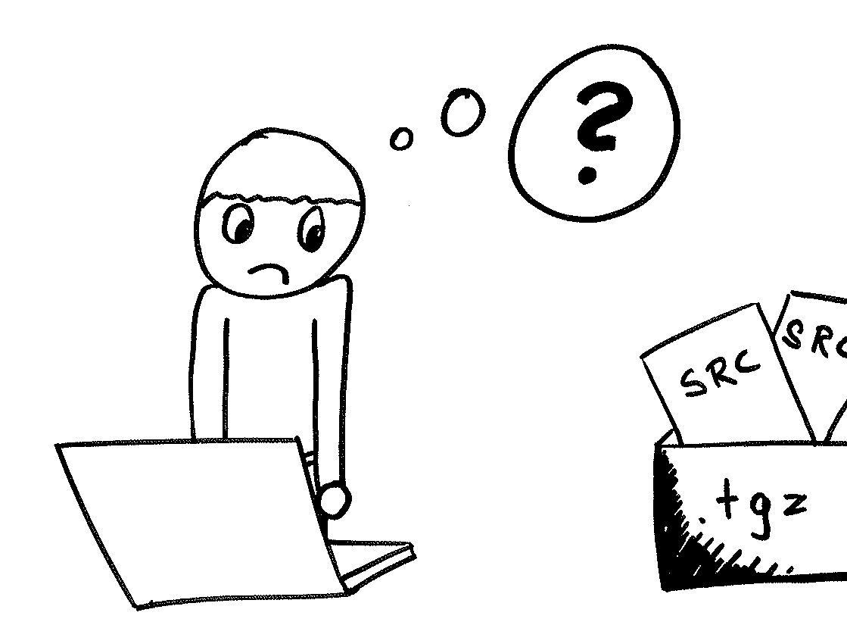
The Users Challenge:
There is so much cool software out there.
The user wants it on its computer, but that is difficult.
openSUSE Buildservice – why its cool.
Robert Lihm
Klaas Freitag

Slide 2
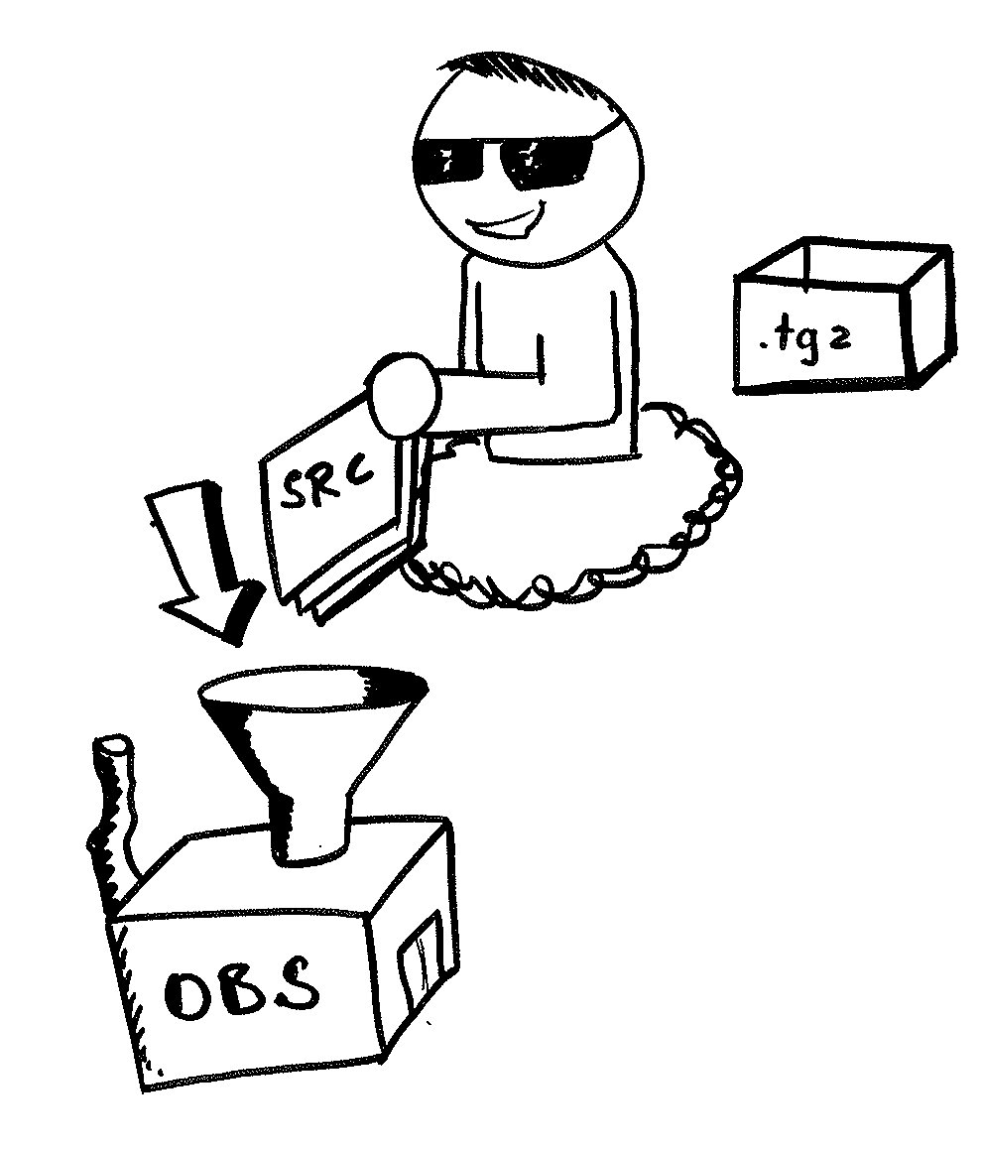
The smart openSUSE Contributor
puts so much interesting tarballs into OBS to build it.
Not too much work.
openSUSE Buildservice – why its cool.
Robert Lihm
Klaas Freitag

Slide 3

OBS builds binary packages.
For so many distributions
For so many platforms
Supporting all ideas
Fostering collaboration
...and makes them available
all over the world
openSUSE Buildservice – why its cool.
Robert Lihm
Klaas Freitag

Slide 4
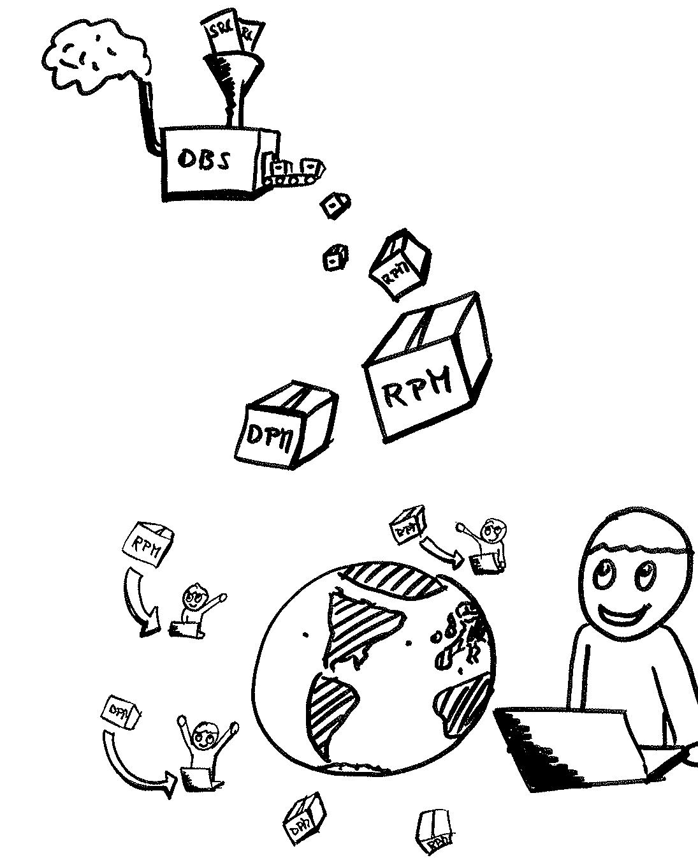
The user can find and install all the nice free software easily and becomes
Happy!
User happy – we all happy. OBS is cool.
openSUSE Buildservice – why its cool.
Robert Lihm
Klaas Freitag

